Slide 1


Department of Computer Science and Engineering
GETO VR WORKSPACE
Kishore MS 211420104134 Laxman Mahadevan R 211420104144 Pradeep K 211420104197
SDG GOALS : 4, 9, 12
Dr. S.Hariharan, M.E,M.TECH., Ph.D
Dr. G.Senthil Kumar, M.C.A.,M.Phil., M.B.A., M.E., Ph.D

Slide 2
Introduction
Communication is a key concept behind every successful organization. It helps us to better understand others and how an organization. Virtual Reality (VR) has become and important tool as technology improves to reach its peak. The concept of virtual reality enables users to interact with a three-dimensional environment through a computer-generated simulation. It can be used in a variety of fields, including medicine, engineering, and entertainment. One of the most common and widely used purpose of VR is for meeting and interacting with people in the computerized simulation. In this paper, we examine the concept of a conference meeting through the use of virtual reality. According to Natalie Massenet, “Always go into meetings or negotiations with a positive attitude.”. This system brings a positivity among users through the use of the immersive VR technology.
2

Slide 3
Objective of the Project
The aim of the project is to improve and replace the traditional approaches of online meeting tools with the current innovation. The proposed system utilizes Oculus technology to create an immersive VR conference room experience thorugh which industrialists and other working professionals can meet and interact with each other. With the help of servers supporting data storage features and mulitplayer capabilities and development and modelling tools such as Unity3d, blender, SketchUp, users can experience the actual conference environment while staying in their desired place. This maintains the professionalism during a presentation
3

Slide 4
Literature Survey
YEARS | AUTHORS | TITLES | METHODOLOGY | ISSUES
2023 | Ashwaq Z. Amat, Deeskha Adiani, Mahrukh Tauseef, Michael Breen, Spencer Hunt, Amy R Swanson, Amy S. Weitlauf, Zachary E. Warren, Nilanjan Sarkar | Design of a Desktop Virtual Reality-Based Collaborative Activities Simulator (ViRCAS) to Support Teamwork in Workplace Settings for Autistic Adults | Virtual Reality | Limitations of interactive environment and use of hand tracking
2023 | Martin Stancek,Ivan Polasek,Tibor Salabai,Juraj Vincur,Rodi Jolak,Michel Chaudron | Collaborative software design and modelling in virtual reality | Virtual Reality | Limitations such as hand tracking ability, used only on VR console
2023 | Ramon Olivia, Alejandro Beacco, Jaime Gallego, Raul Gallego Abellan, Mei Siater | The Making of a Newspaper Interview in Virtual Reality: Realistic Avatars, Philosophy, and Sushi | Metaverse, VR | Limitations of interactive environments
2022 | Chaiyong Ragkhitwetsagul, Morakot Choethiertikul, Apirak Hoonlor, Mores Prachyabrued | Virtual Reality for Software Engineering Presentations | Virtual reality tools such as 1. Hubs 2. FrameVR 3. Spatial.io | Limitations provided by these tools such as restricted room space
4

Slide 5
Existing System
1. VRChat
VRChat is a social VR platform that allows users to create and customize their own avatars and worlds. While it's primarily known for social interactions and gaming, it's also used for virtual meetings, presentations, and events.
2.AltspaceVR
AltspaceVR is a social VR platform that hosts a variety of events, including virtual meetups, conferences, comedy shows, and live performances. It offers customizable avatars, spatial audio, and interactive environments.
3. Mozilla Hubs
Mozilla Hubs is a web-based social VR platform that allows users to create and share virtual spaces with others. It's used for virtual meetings, events, and collaborative workspaces. Hubs is accessible via web browsers and supports various VR headsets.
5

Slide 6
Proposed System
The aim of the project is to improve and replace the traditional approaches of online meeting tools with the current innovation. The proposed system utilizes XR technology to create an immersive VR conference room experience through which industrialists, Clients and other working professionals can meet and interact with each other. With the help of servers supporting data storage features and mulitplayer capabilities and development and modelling tools such as Unity3d, blender, sketchup, users can experience the actual Realtime conference environment while staying in their desired place. This maintains the professionalism during a presentation
6

Slide 7
Software / Hardware used
HARDWARE REQUIREMENTS
1. Personal Desktop
RAM : 16 GB RAM
Graphics Card : Compatible 4 GB Graphics Card
CPU : Ryzen 5 or Intel i5 equivalent CPU or above
2. Internet Router
Download Speed : 25
Mbps, Upload Speed : 5 Mbps.
Router : 5 Ghz WIFI Router.
3. Server Requirements
Account Access : Oculus, Unity Account Access.
Security Services : Access to local networks.
7

Slide 8
Software / Hardware used
SOFTWARE REQUIREMENTS
1. Softwares Used
Unity 3D – version (2021.3.1f1 LTS)
Blender 3D
SketchUp
Oculus Software
SDK: XR Interaction Toolkit
2. Packages Used
Asset Store Originals
XR Interaction Toolkit Package
XR Plugin Manager
Oculus XR
Visual Studio
XR hands
8

Slide 9
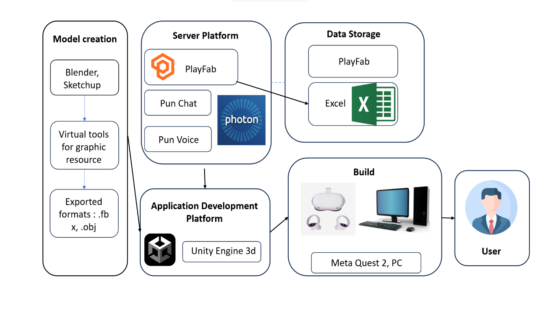
Architecture / Methodology used
Application is created using the Unity 3D software.
Assets are created using the SketchUp and Blender softwares.
Authentication of users is done through the Microsoft PlayFab server.
Communication between users are done through the Pun server.
Rooms are created and joined using the Pun server.
Technology used : Metaverse – Virtual Reality
Database : PlayFab, Microsoft Excel
9

Slide 10
System Implementation
The registration page collects details such as username, email id, password for your account, your role in the organization and phone number.
The login page prompts the user to enter the registered email id and password to verify against the records stored in the Playfab cloud and allows the authorized users to enter into the lobby scene.
The player profile page provides the general data of the current player logged in such as Name, Email, Gender, Phone number and Role of the son in the organization.
Once the player logs in to their account, they can either create a room or join a room. After the room is created by a user, they can sent an invite link to other members via mail , such that others are able to join to the same room.
Users can chat among other users present within the same room. Both public and private messages are supported.
Users can communicate with others present in the room using the PUN voice plugin.
They can present their PPT , PDF, Videos, Images,3D models for their clients and Explain it to them by virtually interacting with it.
Our System is fully Hand tracking for VR which gives the users more immersive experience
10

Slide 11
CONCLUSION
The rapid pace of global development has facilitated effortless connectivity, leading to the emergence of virtual conference rooms, as the next stage beyond traditional video calls. These rooms enable individuals to interact seamlessly as if they were physically present, fostering efficient sharing of work and collaboration. However, coordinating teams across different countries poses significant challenges, including limited progress visibility and difficulties in issue resolution. Moreover, remote work introduces a myriad of challenges such as increased isolation, home office expenses, overworking risks, productivity decline, distractions, workplace disconnection, and imbalanced work-life dynamics. Addressing these challenges is crucial for enhancing remote work efficiency and well-being.
11

Slide 12
FUTURE SCOPE
Looking ahead, the future scope of virtual conference platforms involves integrating meta humans an creating realistic office replicas foe virtual rental, allowing foe streamlined collaboration and efficient workspace design. This innovation holds the promise of revolutionizing markets by enhancing client-developer interaction and facilitating events such as product launches and fairs. By leveraging virtual environments, businesses can overcome geographical barriers and foster meaningful connections, ushering in a new era of remote work and collaborations.
12

Slide 13
Reference Paper/ URL
Empowering Knowledge with Virtual and Augmented Reality, IEEE Access (Volume 11)
The Metaverse: Applications, Concerns, Technical Challenges, Future Directions and Recommendations, IEEE Access (Volume 11)
Design of a Desktop Virtual Reality-Based Collaborative Activities Simulator (ViRCAS) to Support Teamwork in Workplace Settings for Autistic Adults, IEEE Transactions on Neural Systems and Rehabilitation Engineering (Volume 31)
The Making of a Newspaper Interview in Virtual Reality: Realistic Avatars, Philosophy, and Sushi, IEEE Computer Graphics and Applications (Volume 43)
A Step in the Right Direction: Evaluating the Effectiveness of Customized Stepping Game Software and Balance Boards for Balance Rehabilitation Therapy and Measurement, 2023 45th Annual International Conference of the IEEE Engineering in Medicine & Biology Society (EMBC)
13

